Slide 1
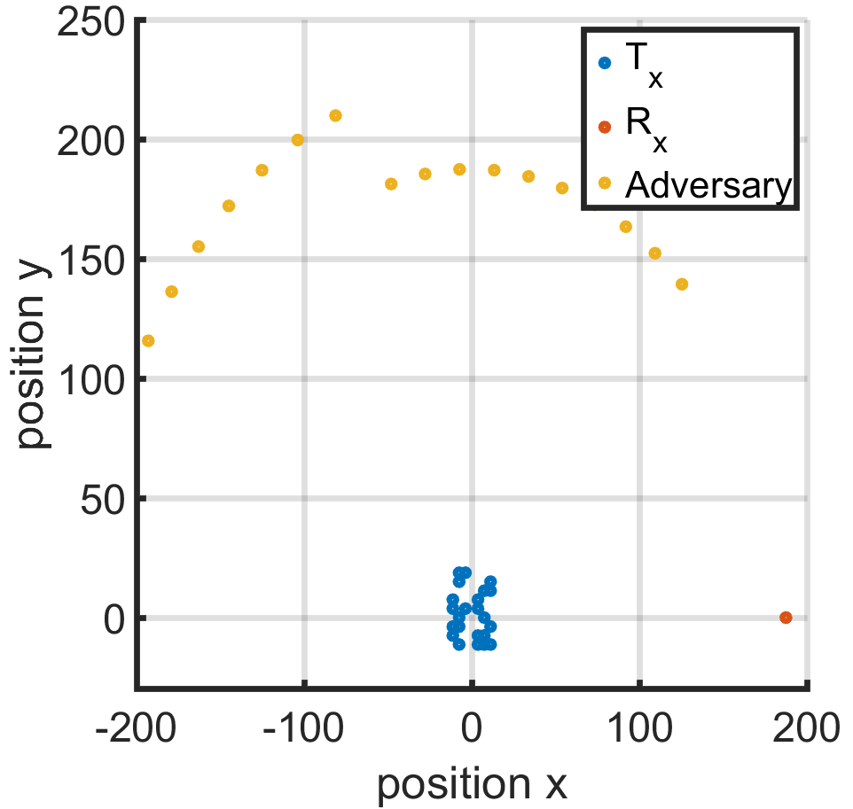
Recreated Kushals Sector based Nullforming IPG Results
22 Tx, 1 allied Rx @ θ = 0, 18 adversaries spaced between π/3 to π

Slide 2
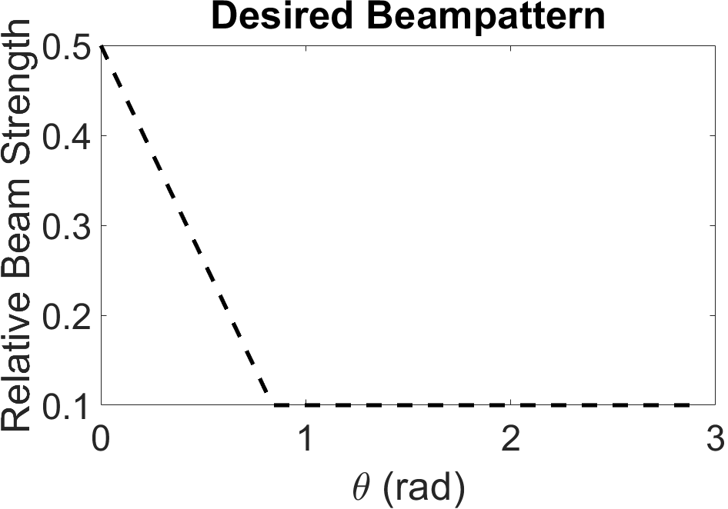
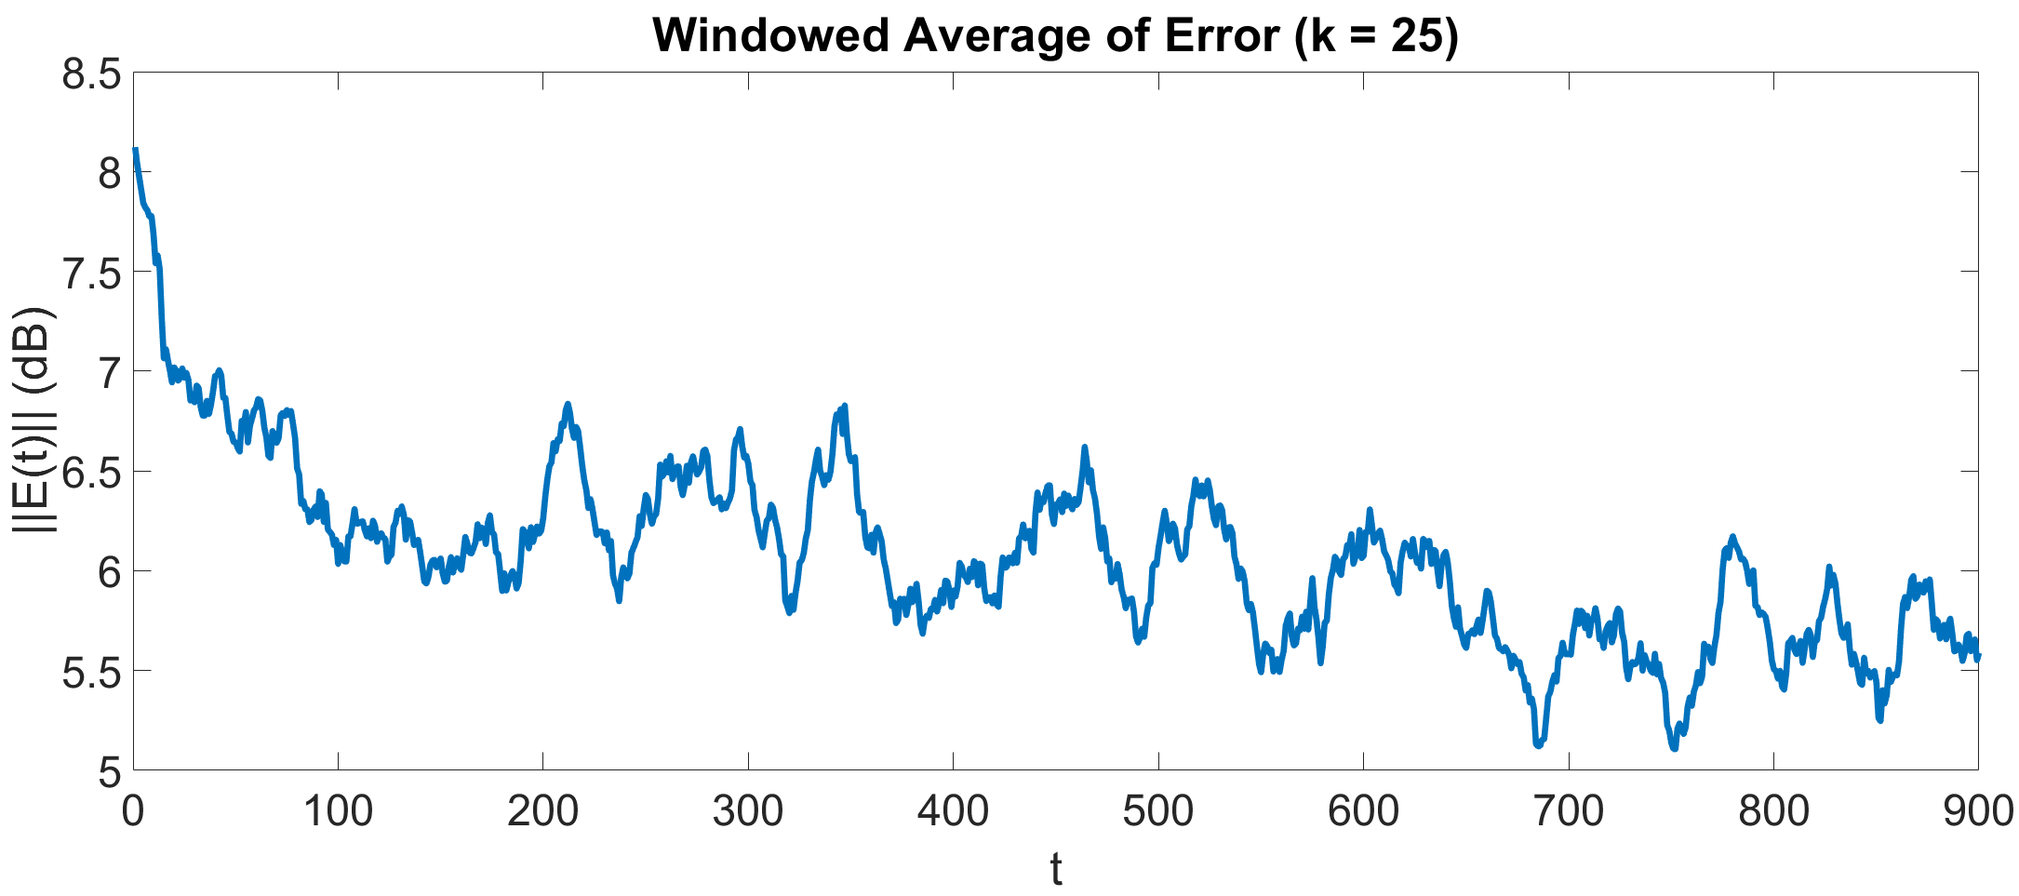
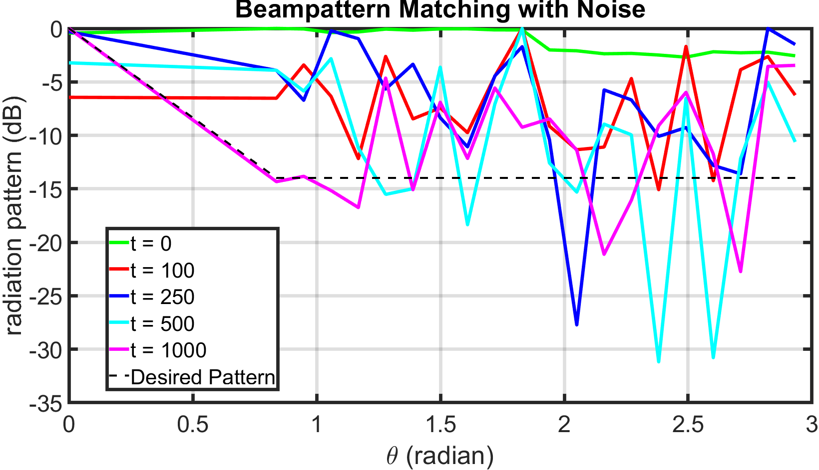
IPG run with flat desired beampattern
Good performance without noise, struggles under noise

Slide 3
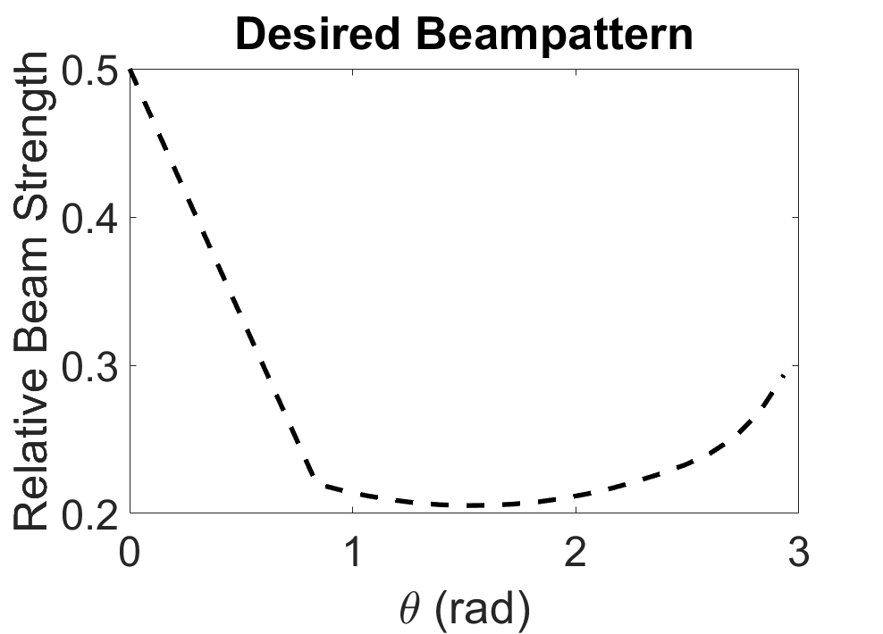
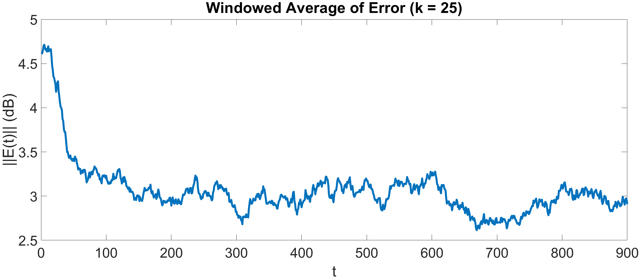
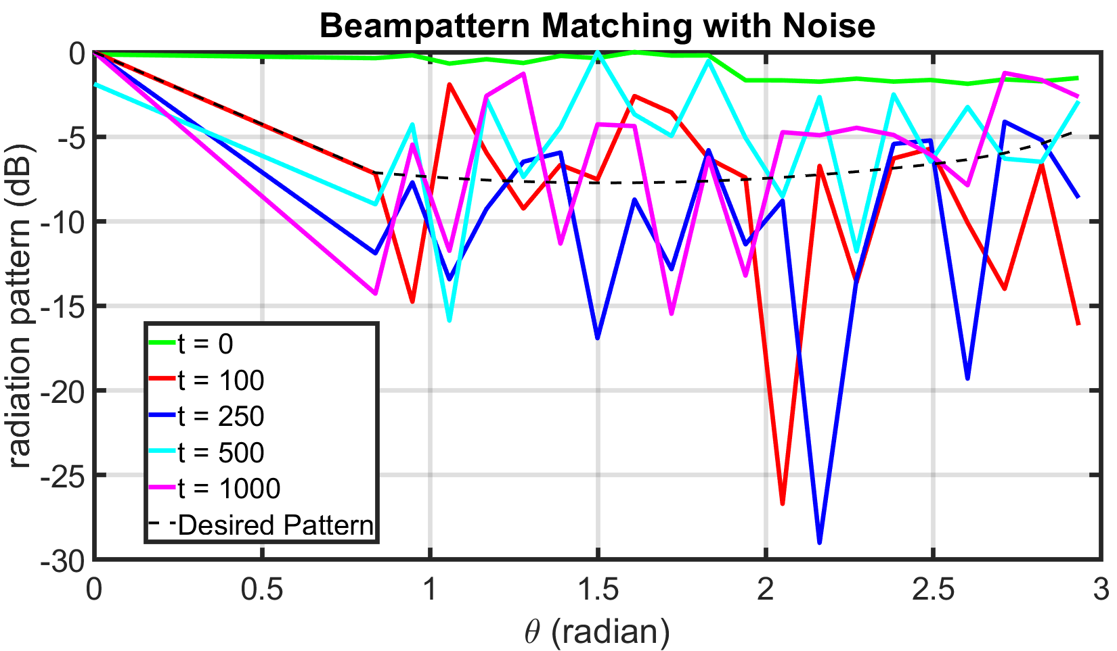
IPG run matching samples from directed beampattern
Replacing flat profile with points from beampattern improves noise robustness

Slide 4
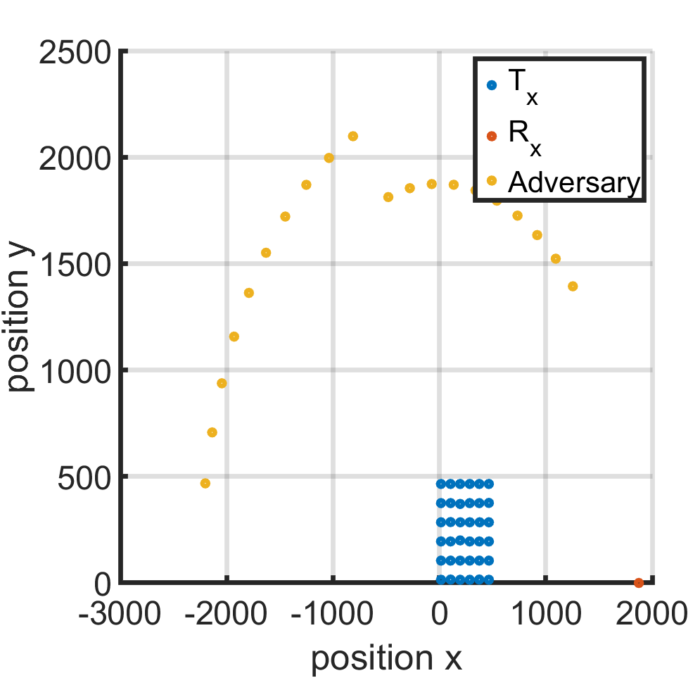
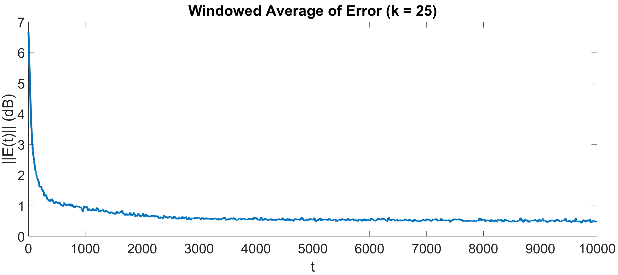
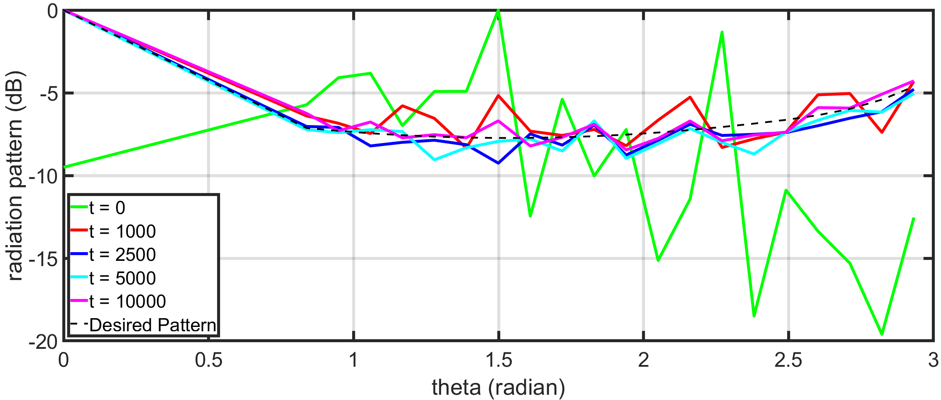
IPG run on 36 node grid (from provided data)

Slide 5
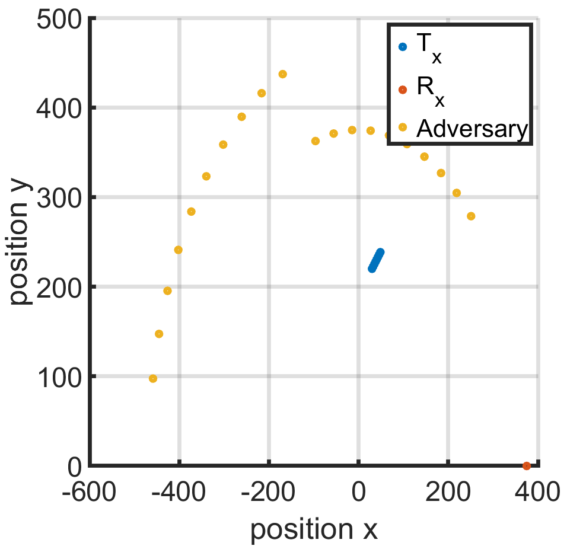
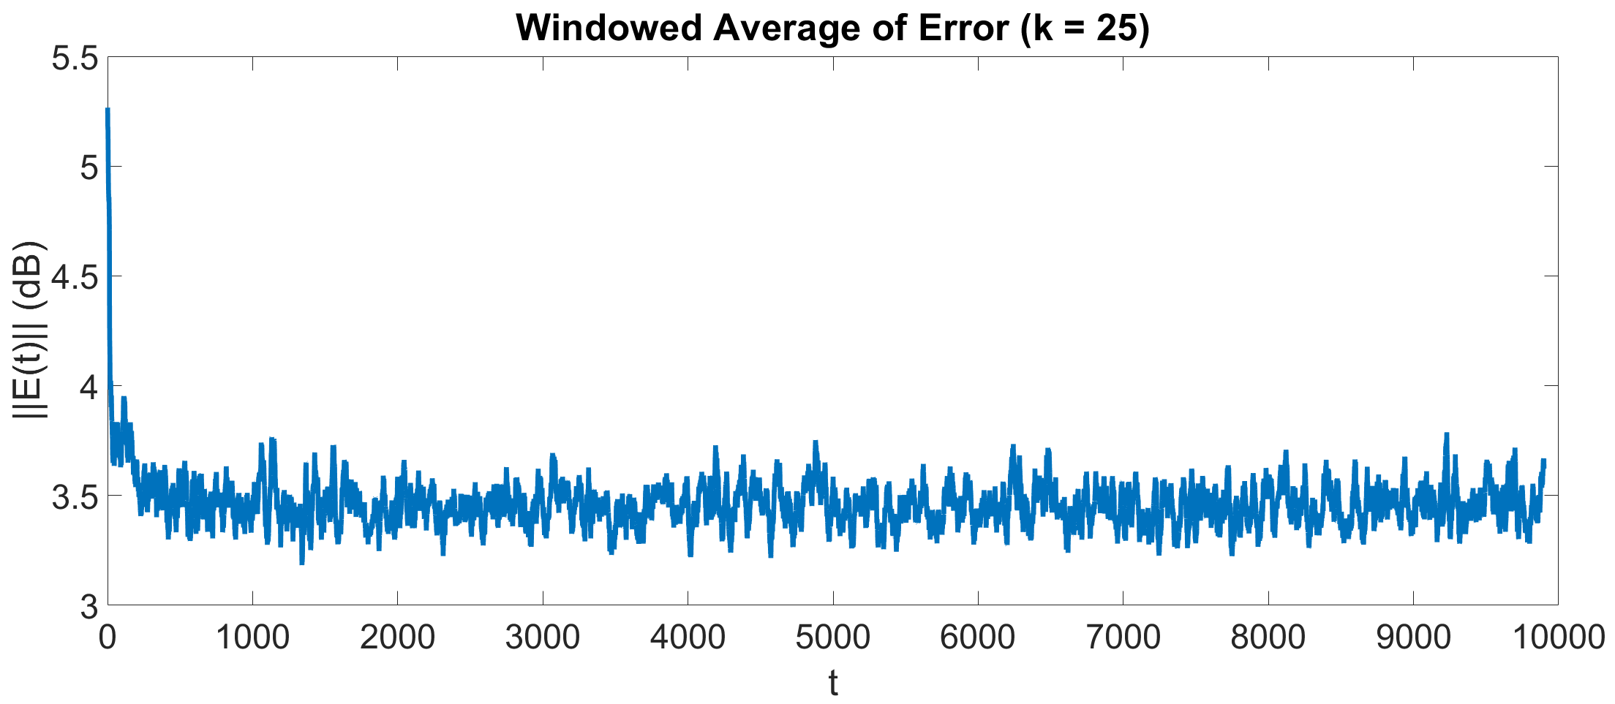
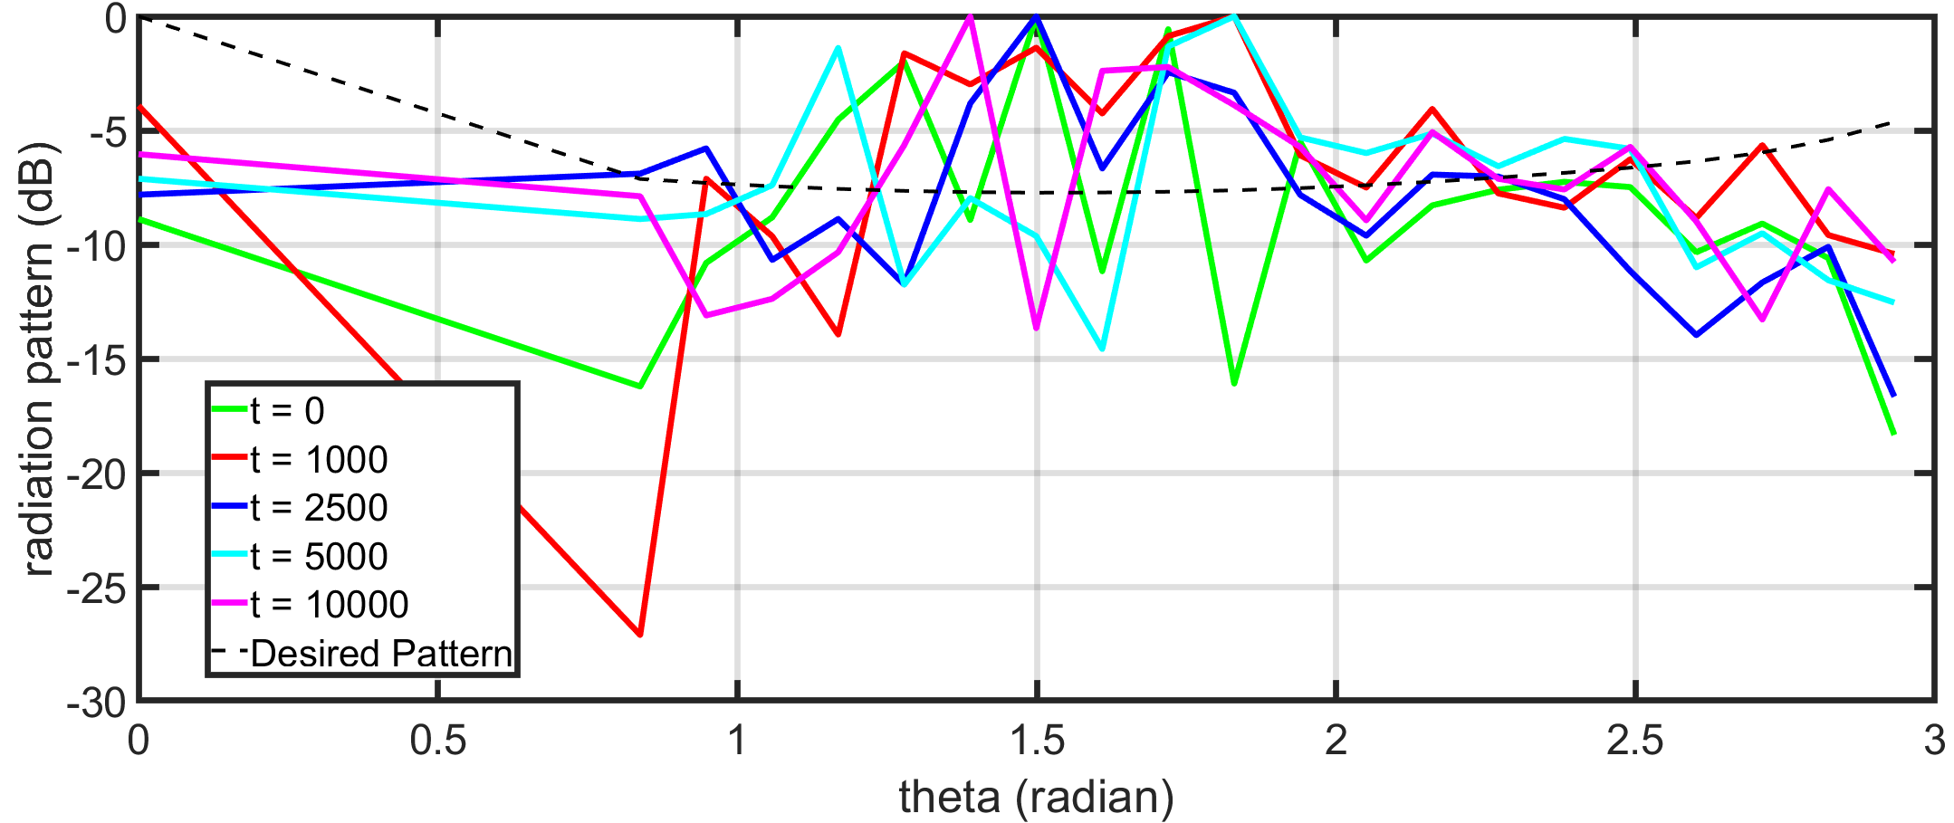
IPG Run with Rx Locations from LA Data (8 Tx)

Slide 6
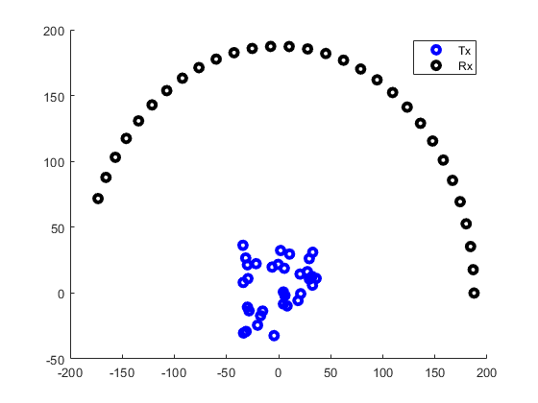
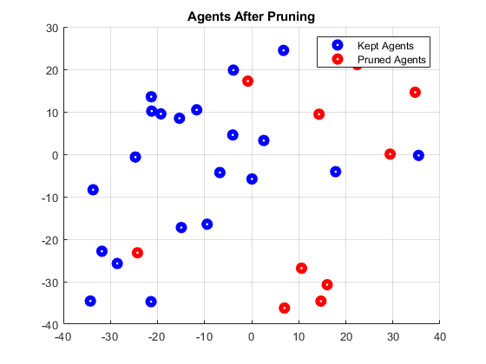
Initial experiment: randomly placed agents, SBL to prune, IPG to further optimize weights
38 reference agents (used to form beam) < 36 test agents (used in optimizer)

Slide 7
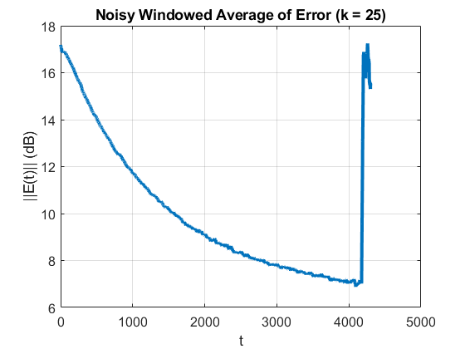
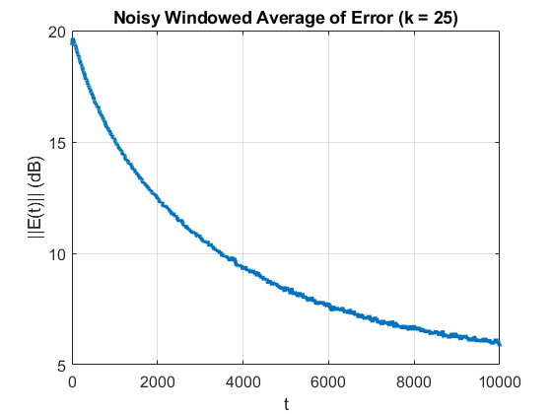
Speed gain consistent with having fewer overall agents
Random agent grids caused divergences with one level IPG, no divergences under two level
IPG Only
IPG with SBL

Slide 8
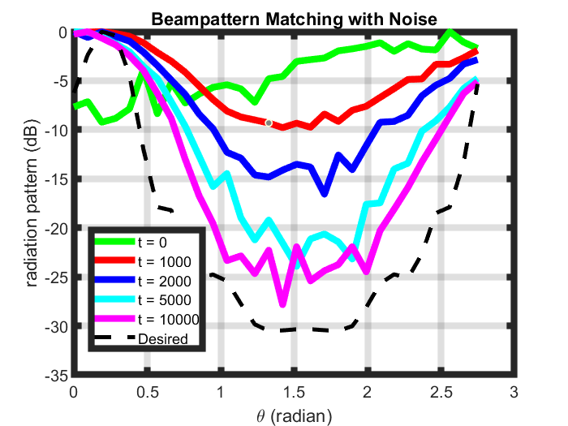
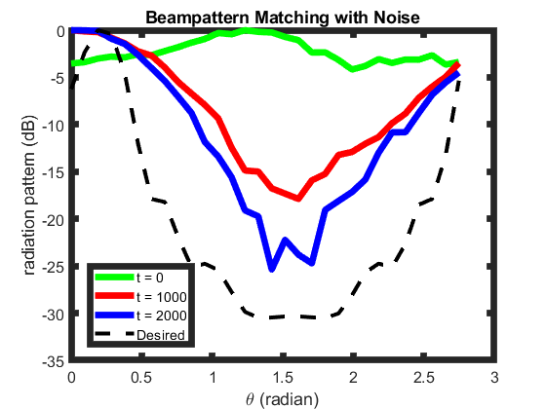
Faster error reduction without pruning agents
IPG Only
IPG with SBL

Slide 9
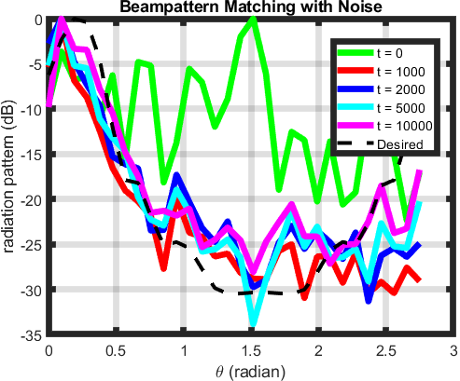
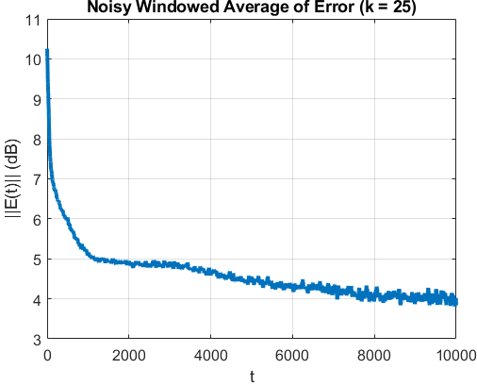
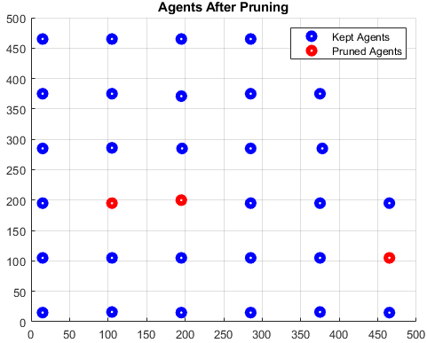
Ran two level (SBL + IPG for weights) on 36 node grid data
Very good performance – able to match beam formed by 38 agents after pruning down to 30 agents in test set

Slide 10
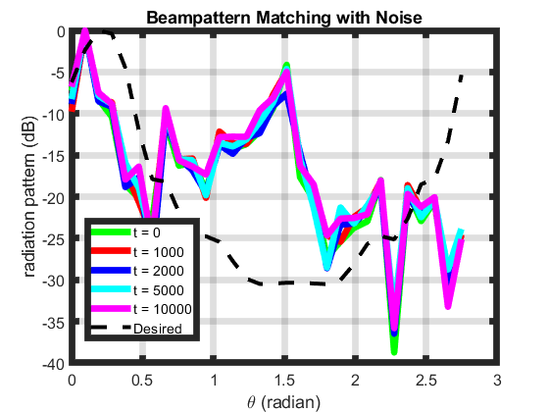

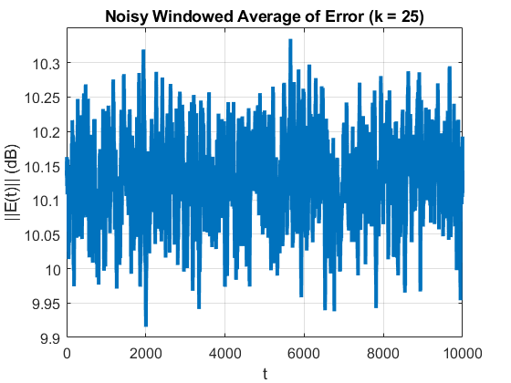
Got working implementation of IPG for agent positions
Algorithm Error never diverges but agents traverse the cost function poorly
The behavior comes from the denominator of the cost function having terms containing the square and cube of distance to receivers – next steps are to penalize fast agent motion to make them look for better local positions

Slide 11
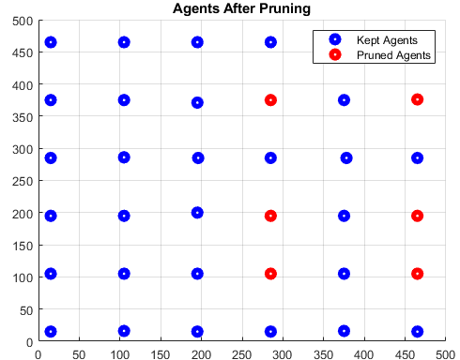
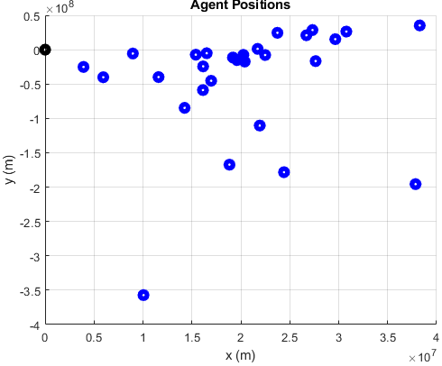
Reran on 36 node grid data, got same results

Slide 12
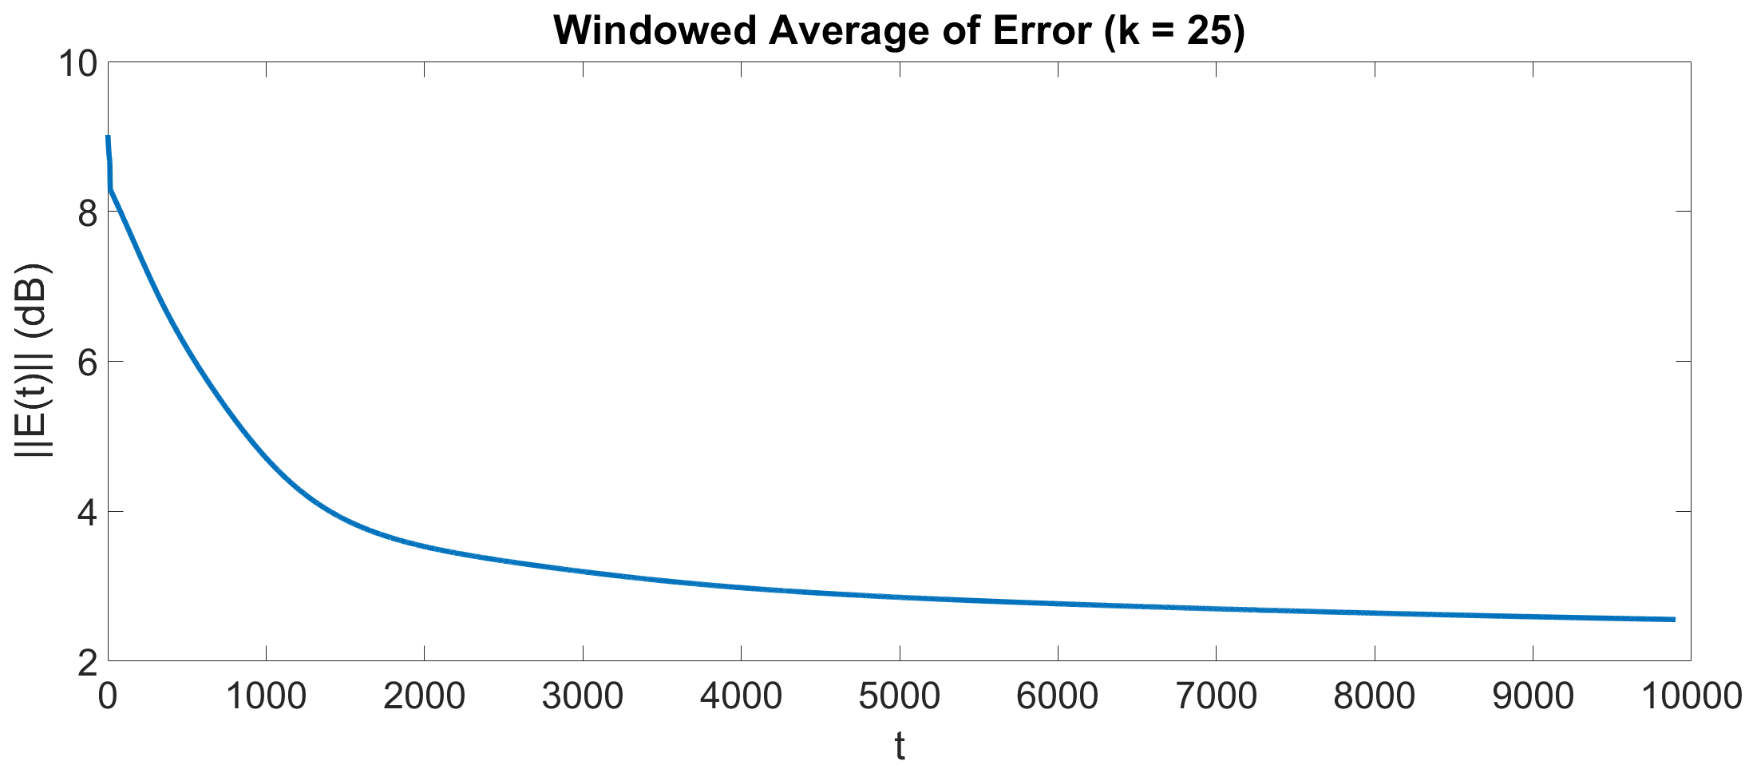
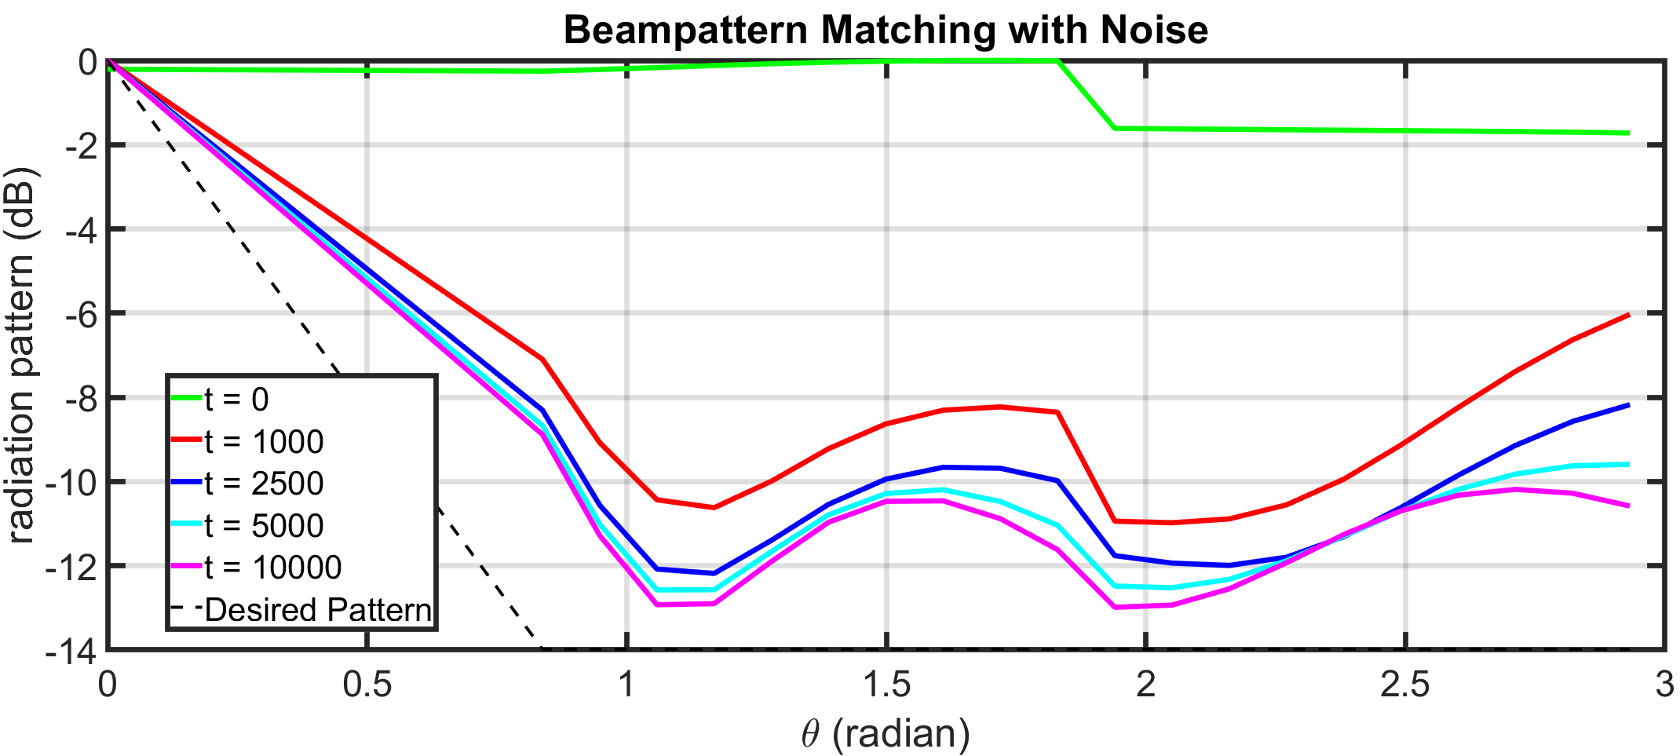
Noiseless Flat Beampattern w/ 22 Tx

Slide 13
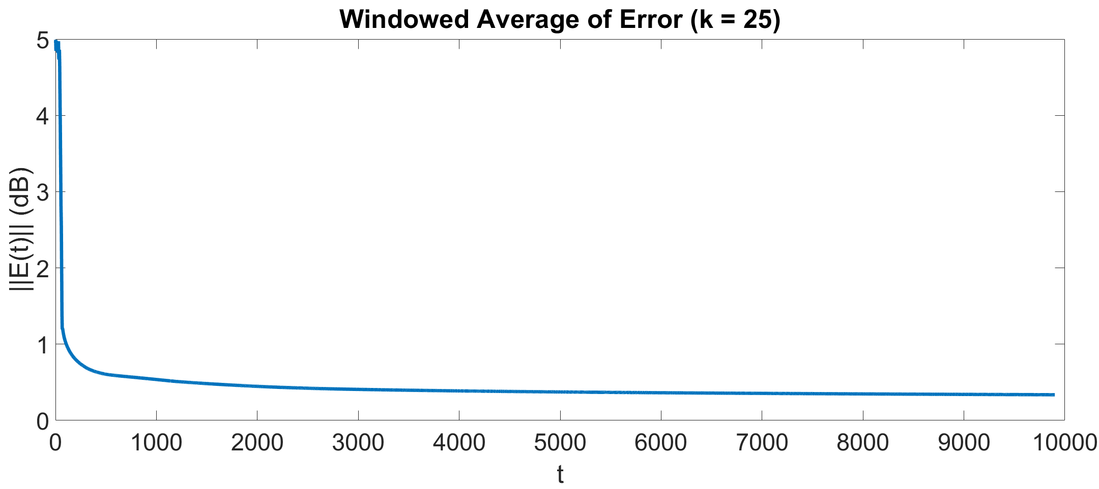
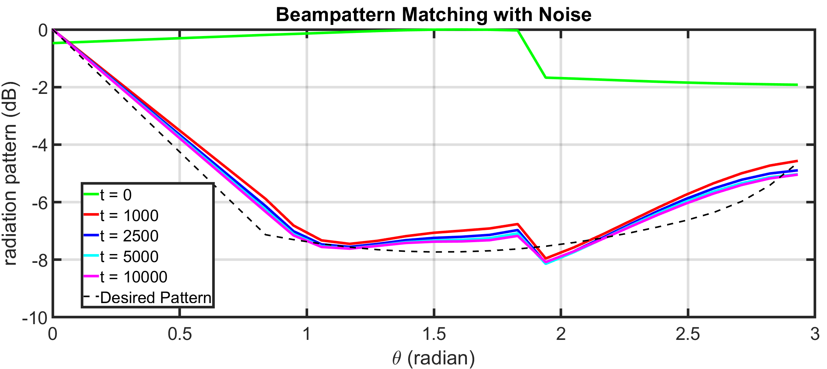
Noiseless Sampled Beampattern w/ 22 Tx

Slide 14
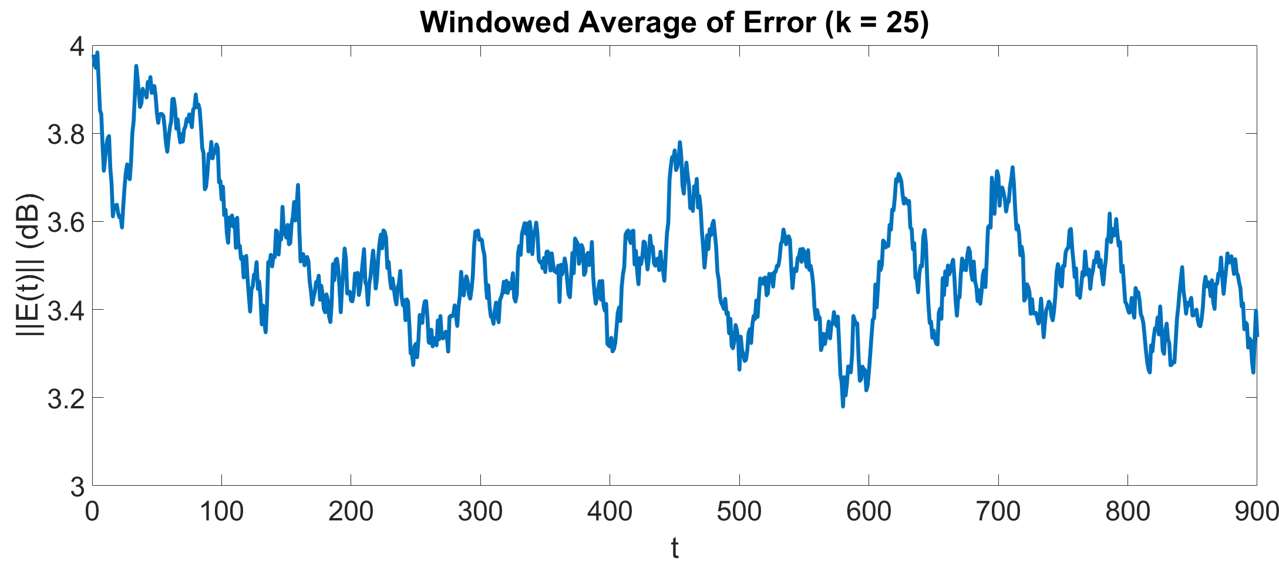
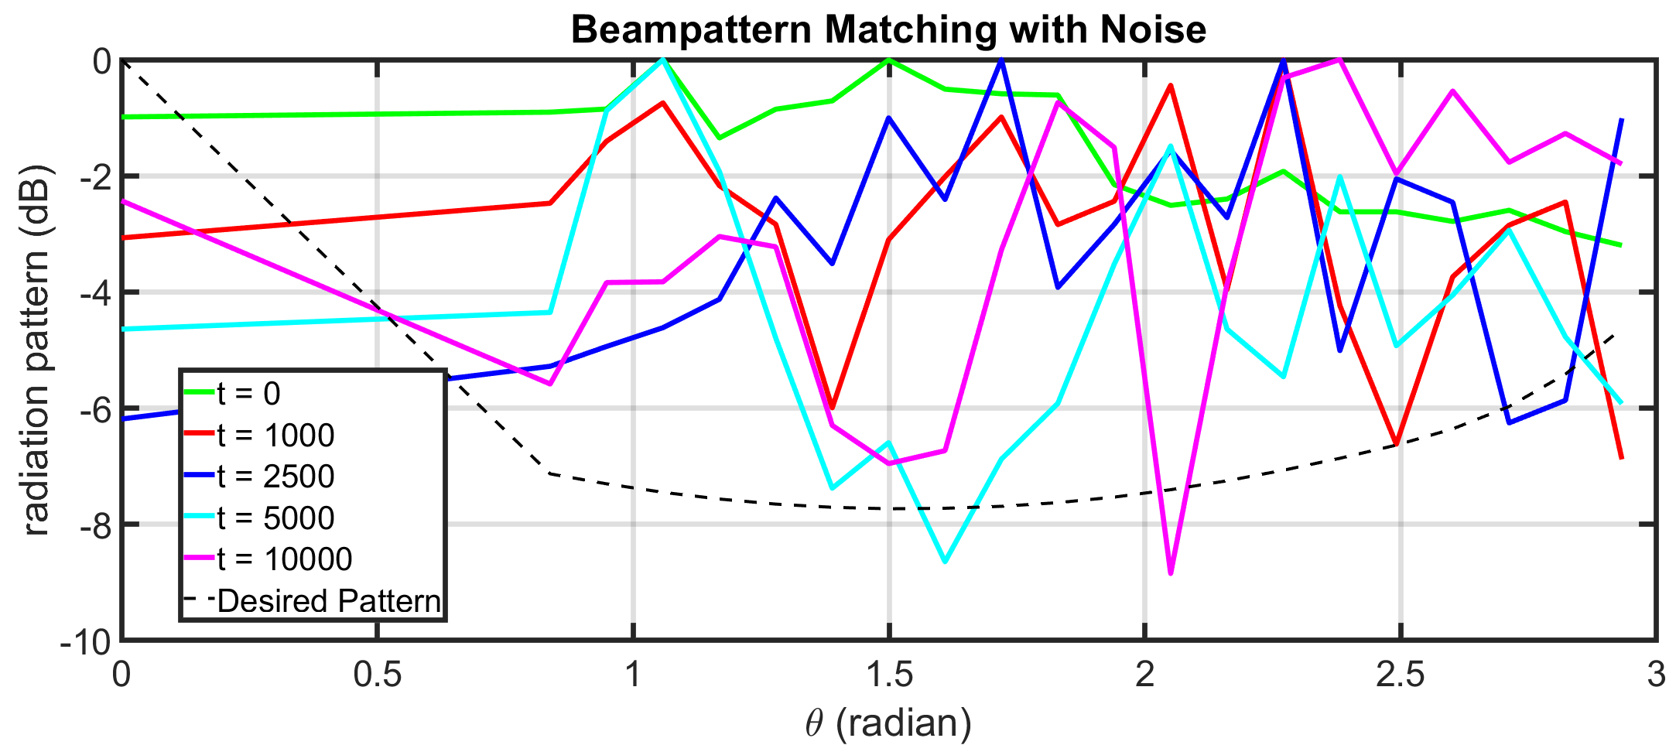
Noisy Sampled Beampattern w/8 Tx

Slide 15
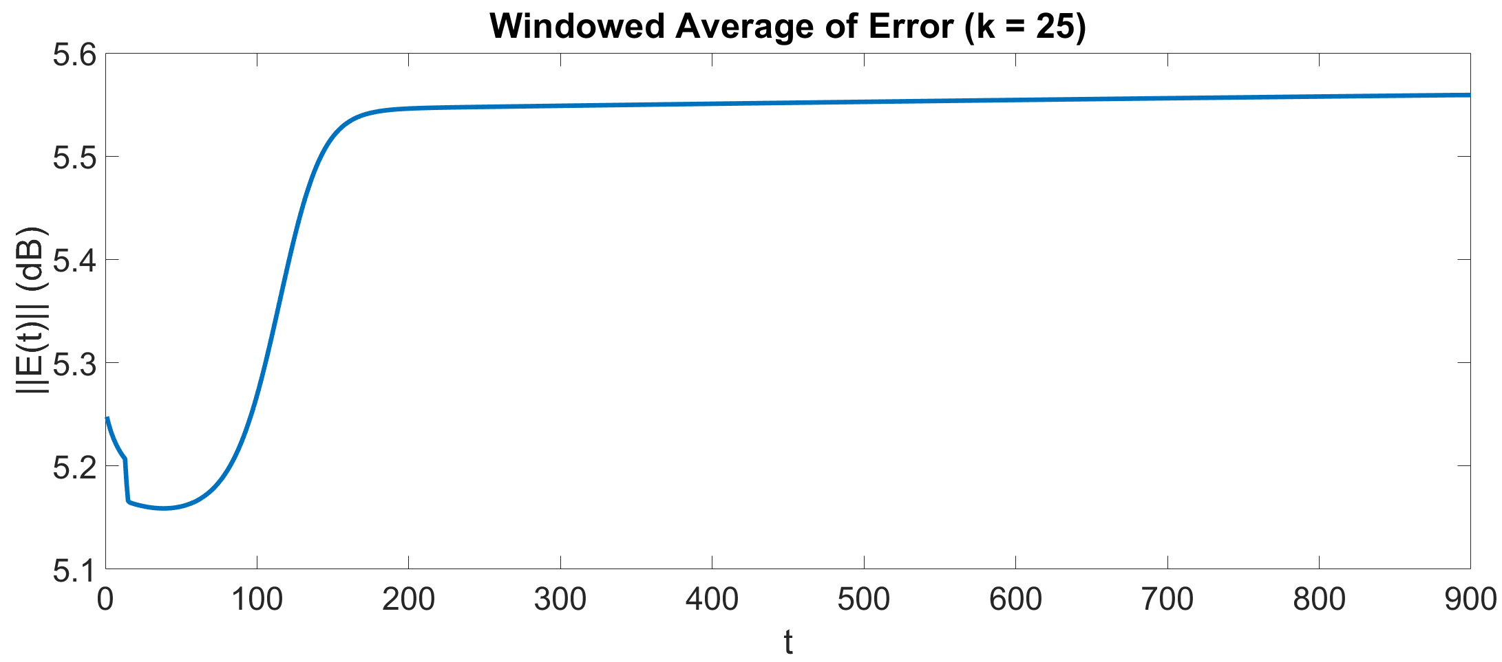
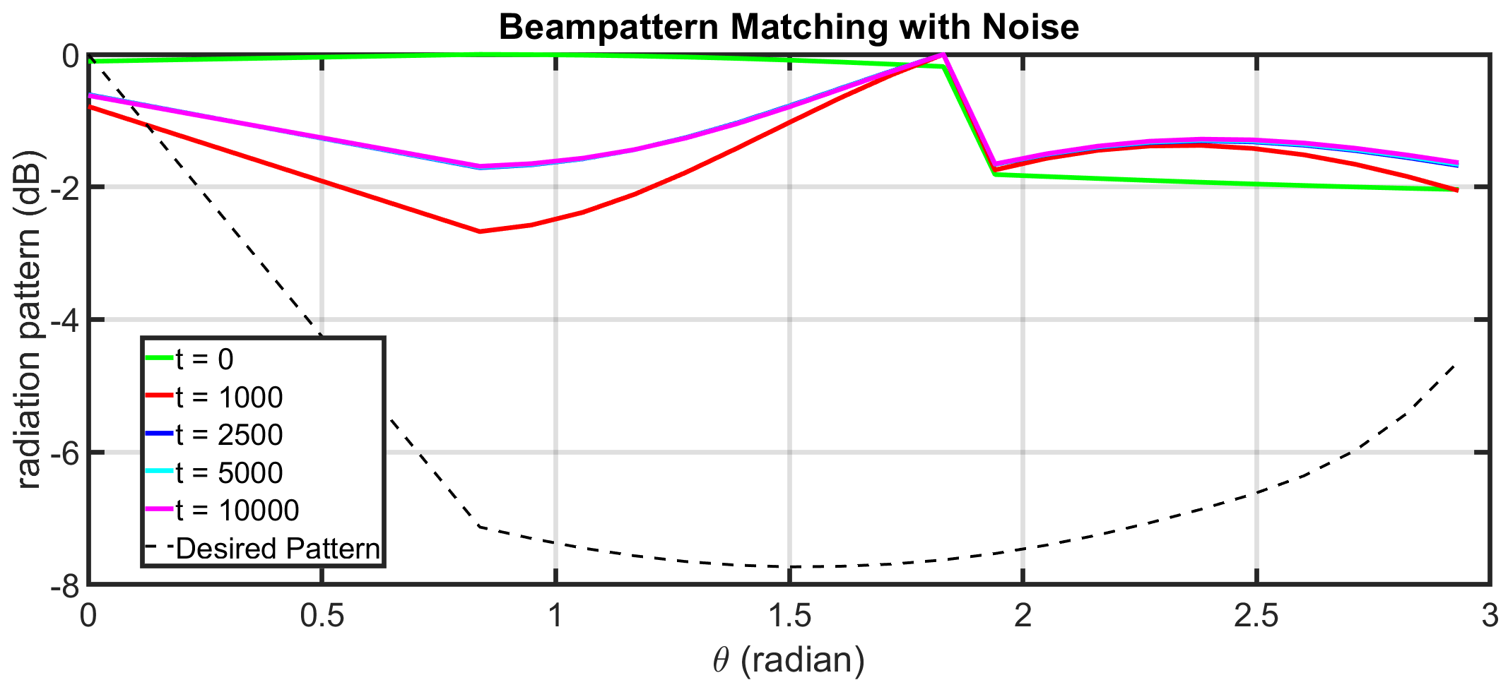
Noiseless Sampled Beampattern w/8 Tx

Slide 16
